Slide 1
Education’s Lifeline

Slide 2
Since 2020 Over 500 Private Institutions Closed… Over 25,000 needy Students lost funding forever..Dept of Education predicts closings “will triple in 10 years!”
Covid-19 fears
More competition from online institutions and tech programs
Shrinking population
Higher tuition
Recruiters lack sales skills to enroll enough students to keep schools open
Mismanaged Admissions staff are wearing down, burning out, and quitting!

Slide 3
The Only Online Sales Training For Recruiters
Staff goes from from burnout to stand out in 90 days…We are the Dale Carnegie sales course for recruiters
‹#›
‹#›

Slide 4
E Entrepreneurial Mindset
N New Foundational Sales Skills
R Results Oriented Strategies
O Results Oriented Implementation
L Leadership Skills
‹#›
‹#›

Slide 5
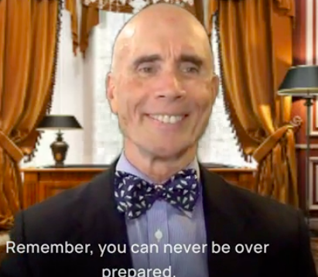
Online Videos
Virtual Playbook
Weekly Zooms
Multi-Sensory Learning
150 pages-30 Steps
Custom Consultations
‹#›
‹#›

Slide 6
Competitive Advantage
 | ROR ENROL Syste | National Associations | Regional Associations | Consulting Firms | Individual Consultants
Best practices | Yes | +Yes | Yes | Yes | yes
Mktg. tools | Yes | Yes | Yes | Yes | Yes
Sales tools | Yes | No | No | No | No
Team Mgnt. | Yes | No | No | No | No
Profle tests Yes No No No No

Slide 7
$1,080,000 Projected 2024 Sales
Our target institutions are in a chronic state of under enrolment… 50% are below budget
TAM (Total Addressable Market)
91,000
Total English speaking private schools and colleges around the world:
24,000
SAM (Serviceable Available Market)
Under enrolled institutions
2,400
SOM (Serviceable Obtainable Market)
We expect 36 sales per of $30,000 each per year (1.5% of SOM market per year)=$1,080,000, and double revenue each year for the next five years to reach= $16,000,000.
Access For The Underserved
‹#›
‹#›

Slide 8
32% increase in 3 years!
*ENROL Training Revenue

Slide 9
Product Milestones
2020
2021
2023
Bootstrapped and Profitable in 90 Days!

Slide 10
Traction
$30,000
Training course fee
Annual Revenue
Customer Acquisition Cost
$40,000
$200,000
Revenue per Average Customer
$833.00.
$65,000
Client Life Value
Lead Conversion Rate
Net Promoter Score
200%
Customer base has grown in three years
13
21%

Slide 11
Diverse AI Infused Marketing
National and regional association fairs
Aggressive social media campaign
Paid virtual advertising
National magazine advertising
Commissioned sales force
Targeted CRM email campaigns
‹#›
‹#›

Slide 12
1,000,000 Additional Capital will allow us to:
Expand our infrastructure
National Marketing campaign
$300,000
$1,500,000
Hire more trainers
Enlarge our sales force
$450,000
$750,000

Slide 13
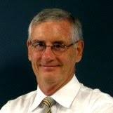
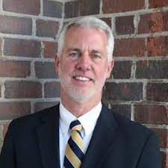
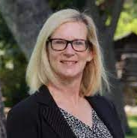
Results!
Peter Thorp
Headmaster Emeritus
Michael Robinson
Head of Stuart Hall
Robin Jarchow
Head of Southwestern Academy
Tom Schenck is a leader in the field of recruiting. He is a brilliant combination of long experience, imaginative strategic thinking and success, that's so important in these unprecedented and challenging times.
Tom, your materials are masterful! The pedagogical organization inspires recruiters to excel and grow. Both rookies and pros know it will take them to the next level. Your secret sauce makes people great!
Tom’s dynamic personality and creative approach changed our team’s mindset from passive to entrepreneurial … We added over 2,000 referrals and dramatically increased our applications and enrollment!

Slide 14
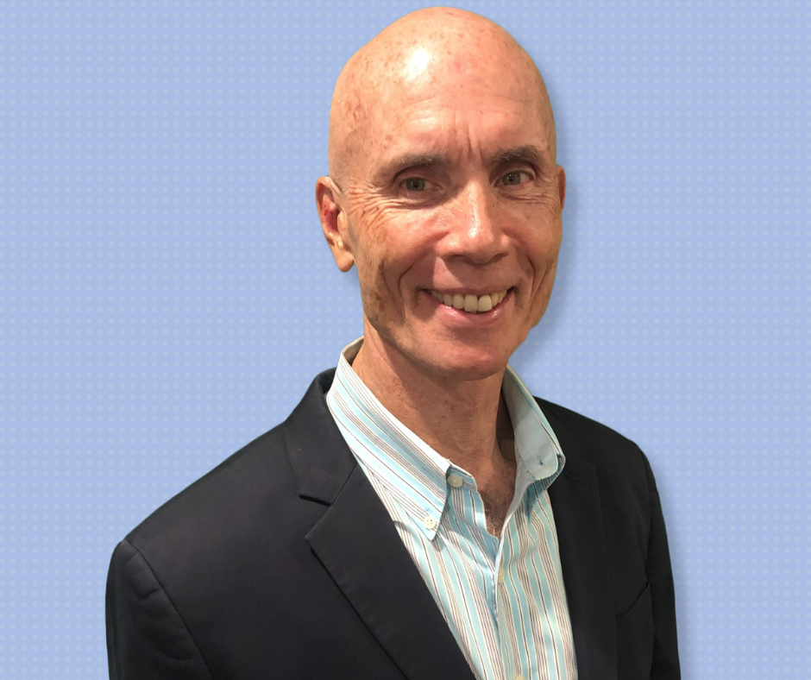
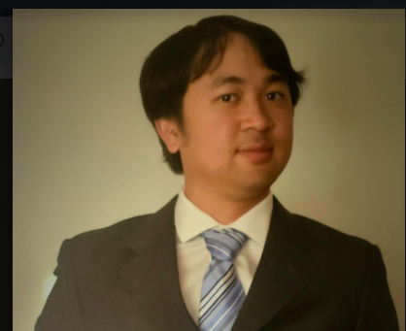
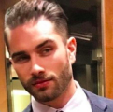
The Team
Tom Schenck
CEO
Melandrew Santos
CFO
Hagan Schenck
Vice President for Branding
An entrepreneur with over 40 years of successful educational leadership and top 1% sales rainmaker
15 years in all aspects of corporate financial 0versite and SEC relations
New York entrepreneur, nationally recognized artist

Slide 15
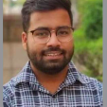
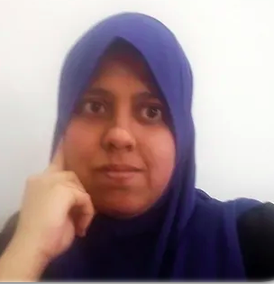
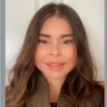
The Team
Chiranjeev Dutt
Chief Technology Officer
Trey Prey
Dir. of Global Outreach,
Sadat Jabeen
Chief Editor of ROR Magazine
Ceci Guzaman
Operations Manager
A digital marketing expert, oversees all global technology,. MBA in Marketing and Finance.
Aligns podcasts across all audio and visual platforms. Previously he founded Hype Music Network
A prolific freelance Writer, Professor of Ed Psychology,
Oversight of all divisional logistics. Highly organized, Adept at creating contingency solutions.

Slide 16
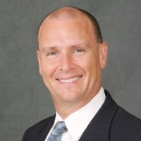
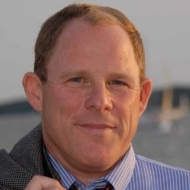
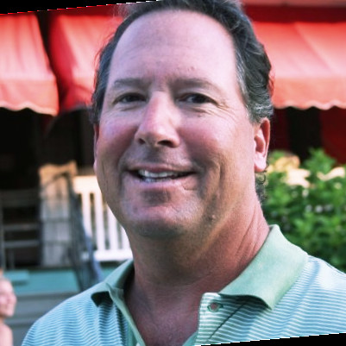
Advisors
Craig Candelore
Dr. Jerry Larson
Patrick Finn
Partner ,Men’s Legal Center
Managing Partner
Founder of Schools Connections,
US Army Colonel
West Point
Educational Directions, inc.. 40 years of educational leadership as head of school and trustee in the US and abroad
A global marketing firm that matches schools and consultants..43 years of school leadership throughout the mid- Atlantic

Slide 17
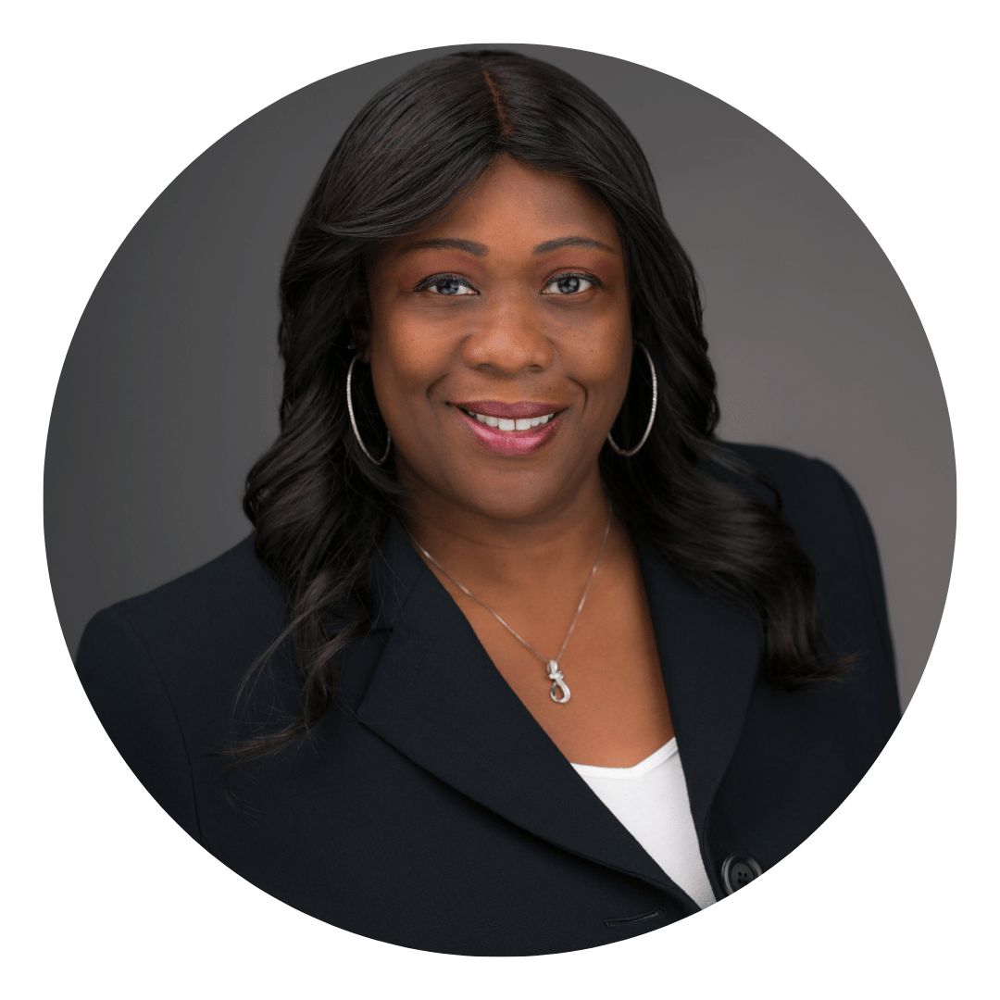
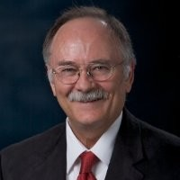
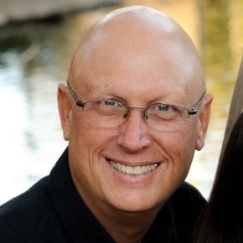
Advisors
Mike Adams
Maisha Cobb
Steve Morley
Founder of the Compass
Brink Advisory Board
Founder, Esguard.io
A series of predictive, assessment systems. Serial Entrepreneur for 40 years
Strategic Mktg Exec who builds high performance organizations
Senior start-up Advisor for University of San Diego. Former, Founding Employee of Qualcomm

Slide 18
$3 Million
Investment requested
Access For The Underserved
‹#›
‹#›

Slide 19
CONTACT US
717 538-6000
Co-optrade@proton.me
www.co-optrade.com
12345 No Main Street San Diego, CA 91932
Access For The Underserved
‹#›
‹#›

Slide 20
THANK YOU
for your kind Consideration!
We Look forward to working with you.
Access For The Underserved

